Slide 1
Lecture 7 Dr. Suha K. Shihab
PERMANENT-MOLD CASTING PROCESSES
CENTRIFUGAL CASTING
refers to several casting methods in which the mold is rotated at high speed so that centrifugal force distributes the molten metal to the outer regions of the die cavity.
the centrifugal casting methods includes:
True Centrifugal Casting.
Semicentrifugal Casting.
(3) Centrifuge Casting.

Slide 2
Lecture 7 Dr. Suha K. Shihab
True Centrifugal Casting
In this process the molten metal is poured into a rotating mold to produce a tubular part. Examples of parts made by this process include pipes, tubes, bushings, and rings. One possible setup is illustrated in Figure 1. Molten metal is poured into a horizontal rotating mold at one end. In some operations, mold rotation commences after pouring has occurred rather than beforehand. The high-speed rotation results in centrifugal forces that cause the metal to take the shape of the mold cavity. Thus, the outside shape of the casting can be round, octagonal, hexagonal, and so on. However, the inside shape of the casting is (theoretically) perfectly round, due to the radially symmetric forces at work.
FIGURE 1 Setup for true centrifugal casting.

Slide 3
Lecture 7 Dr. Suha K. Shihab
Orientation of the axis of mold rotation can be either horizontal or vertical, the former being more common.
in horizontal centrifugal casting for the process to work successfully. rotational speed is calculate from the equation 1:
Where
N=rotational speed, rev/min
g = acceleration of gravity, 9.8 m/s²
D = outside diameter of the mold, m
G-factor GF is the ratio of centrifugal force (F) divided by weight (W).
Values of GF =60 to 80 are found to be appropriate for horizontal centrifugal casting
F = mv²/R , W = mg so GF = v²/Rg
GF = (RπN/30)²/Rg =R (πN/30)²/g
Example A true centrifugal casting operation is to be performed horizontally to make copper tube sections with OD = 25 cm and ID = 22.5 cm. What rotational speed is required if a G factor of 65 is used to cast the tubing?
Solution:
The inside diameter of them old D=OD of the casting = 25 cm = 0.25 m. We can compute the required rotational speed is:
N= (30/π)((2(9.8) (65)/0.25))^{0.5} = 681.7 rev/min

Slide 4
Lecture 7 Dr. Suha K. Shihab
In vertical centrifugal casting, casting, the effect of gravity acting on the liquid metal causes
the casting wall to be thicker at the base than at the top. The inside profile of the casting wall takes on a parabolic shape. The difference in inside radius between top and bottom is related to speed of rotation as follows in equation :
where L = vertical length of the casting, m
R_{t} = inside radius at the top of the casting, m
R_{b} = inside radius at the bottom of the casting, m
Castings made by true centrifugal casting are characterized by:
high density, especially in the outer regions of the part where F is greatest.
Solidification shrinkage at the exterior of the cast tube is not a factor, because the centrifugal force continually reallocates molten metal toward the mold wall during freezing.
Any impurities in the casting tend to be on the inner wall and can be removed by machining if necessary.

Slide 5
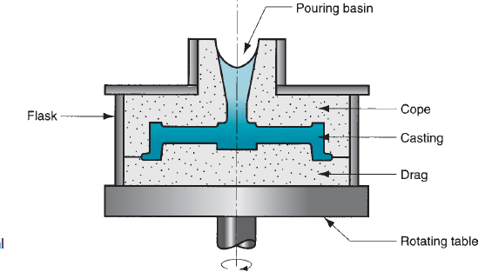
Lecture 7 Dr. Suha K. Shihab
Semicentrifugal Casting
In this method, centrifugal force is used to produce solid castings, as in Figure 2, rather than tubular parts. The rotation speed in semicentrifugal casting is usually set so that G-factors of around 15 are obtained and the molds are designed with risers at the center to supply feed metal. Density of metal in the final casting is greater in the outer sections than at the center of rotation. Wheels and pulleys are examples of castings that can be made by this process. Expendable molds are often used in semicentrifugal casting.
FIGURE 2 Semicentrifugal
casting.

Slide 6
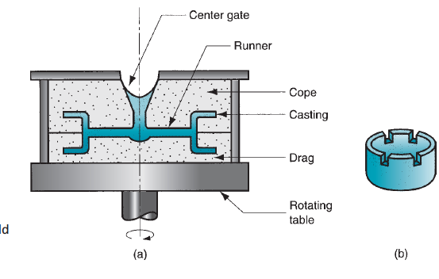
Lecture 7 Dr. Suha K. Shihab
Centrifuge Casting
In centrifuge casting, Figure3, the mold is designed with part cavities located away from the axis of rotation, so that the molten metal poured into the mold is distributed to these cavities by centrifugal force. The process is used for smaller parts, and radial symmetry of the part is not a requirement as it is for the other two centrifugal casting methods.
FIGURE 3 (a) Centrifuge casting-centrifugal force causes metal to flow to the mold cavities away from the axis of rotation; and (b) the casting.

